Slide 1

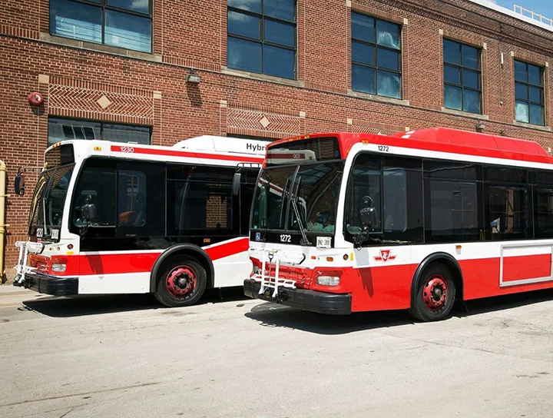
Toronto Bus Delays
Group 04
Pramudi Rajamanthri - s14853
Vidura Chathuranga - s15030
Chalani Wijemunige - s15091

Slide 2

Introduction to the dataset
Toronto Transit Commission bus system carry over 264 million riders in 192 bus routes (including 28 night bus routes) and contains buses travelling 143 million kilometers in the year
Also this dataset contains data on delay cases reported during the first 6 months of 2022 in Toronto, Canada.

Slide 3

Main
Objective
Identify the most important factors in predicting the delay time of buses.
To develop a predicting model in order to predict delay time of the buses in Toronto based on the affecting factors.

Slide 4
Variables
of the Dataset
The Toronto bus delays 2022 dataset contains 27351 records and 10 variables, including Delay time as the response variable.
Date | Route | Time | Day | Location | Incident
Qualitative | Qualitative | Quantitative | Qualitative | Qualitative | Qualitative
Min.Delay | Min.Gap | Direction | Vehicle
Quantitative | Quantitative | Qualitative | Qualitative

Slide 5



Pre Processing &
Feature Engineering
Altered variables Direction
New variables created out of original variables Date Month Route Route_New Time Hour Day Is_Weekday Incident Incident_New
Removed variables Vehicle
Remove duplicated entries
Remove records having 0 as Min.Delay and Min.Gap
Feature Engineering
Filter records with errors in days, time and route which were identified by referring to the “TTC bus system" website.
Impute missing values
Split the dataset into training and testing datasets

Slide 6

Main Results of the
Descriptive Analysis

Slide 7
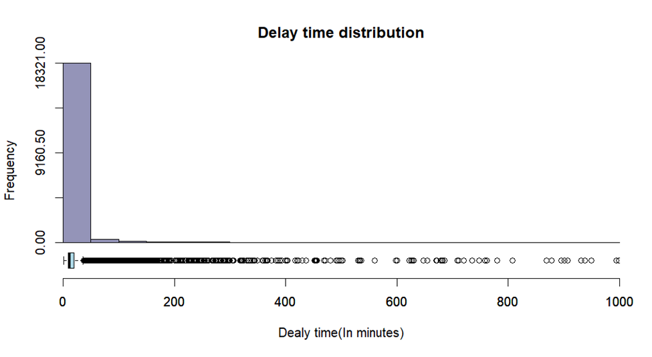
Delay Time Distribution
Boxplot Stats
Minimum - 1
1st Quartile - 9
Median - 12
3rd Quartile - 20
Maximum - 36
Mean - 18.3
Skewness – 7.05678
Kurtosis – 62.70986

Slide 8
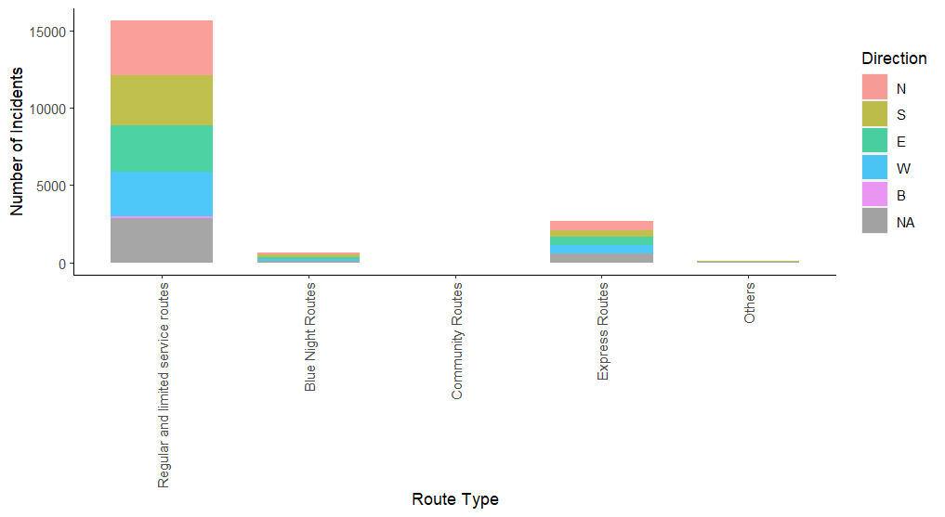
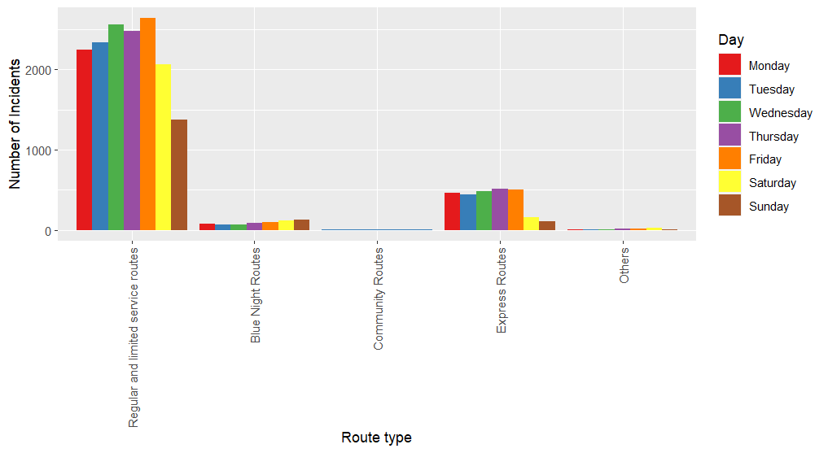
Impact of the Direction and Days with
Route Type
Route type | Number series | Time scheduled
1.Regular and Limited Service Routes | 7 – 189 series | Weekdays – 6am-1am Weekends - 8am-1am
2.Blue Night Routes | 300 -399 series | Weekdays – 1am-6am Weekends - 1am-8am
3.Community Routes | 400 – 499 series | Only in rush hours of weekdays Rush hours (According to TTC statistics) :- Morning – 6am- 10am Evening - 3pm- 7pm
4.Express Routes | 900 – 999 series | Any time with in the 24 hours (according to requirements)

Slide 9
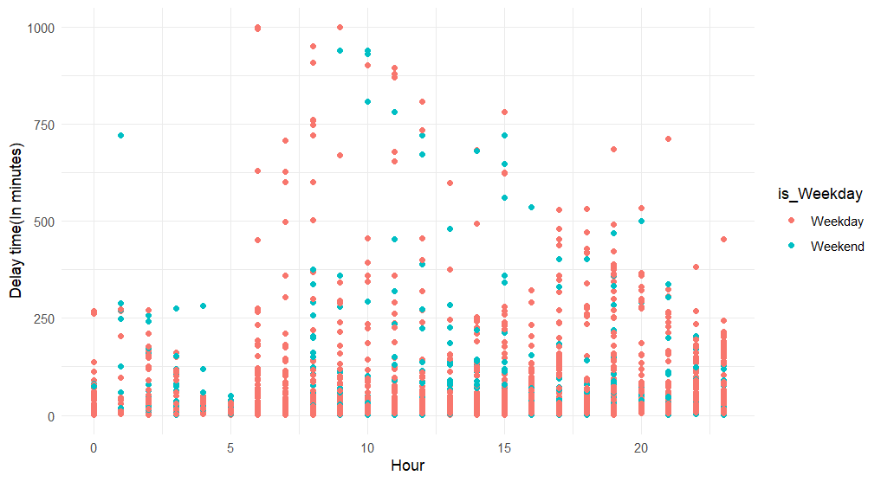

Delay Cases VS
Hour
According to GlobalNews sources, (https://globalnews.ca/tag/toronto-bus-delays/)
the school hours are from 8.45 a.m to 3.20 p.m which causes immense traffic jams in both bus route system and sub way system in Toronto.
MAJORITY IS HERE

Slide 10
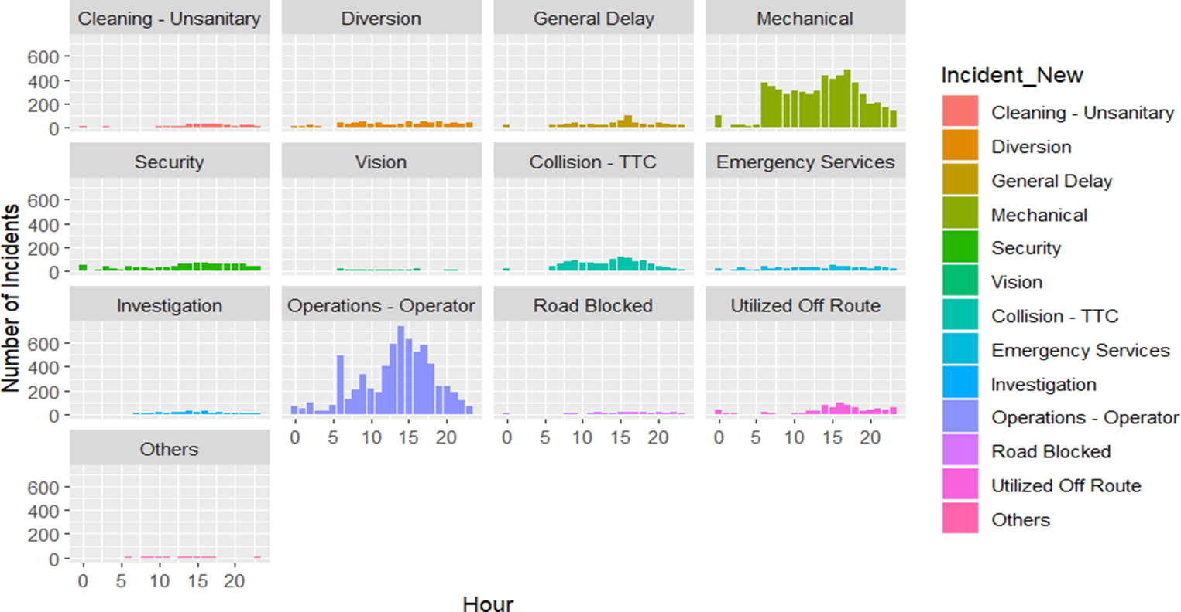
Impact of the
Time and Incident type
According to cp24 sources, (https://www.cp24.com/news/cleaning-now-the-leading-cause-of-ttc-bus-delays-amid-covid-19-pandemic-1.5534154?cache=%3FclipId%3D104070%3FautoPlay%3Dtrue%3FautoPlay%3Dtrue%3Fot%3DAjaxLayout#:~:text=Mechanical%20issues%20were%20to%20blame,accounted%20for%20six%20per%20cent.)
Mechanical issues has been one of the major causes of bus delays during the pandemic situation.

Slide 11
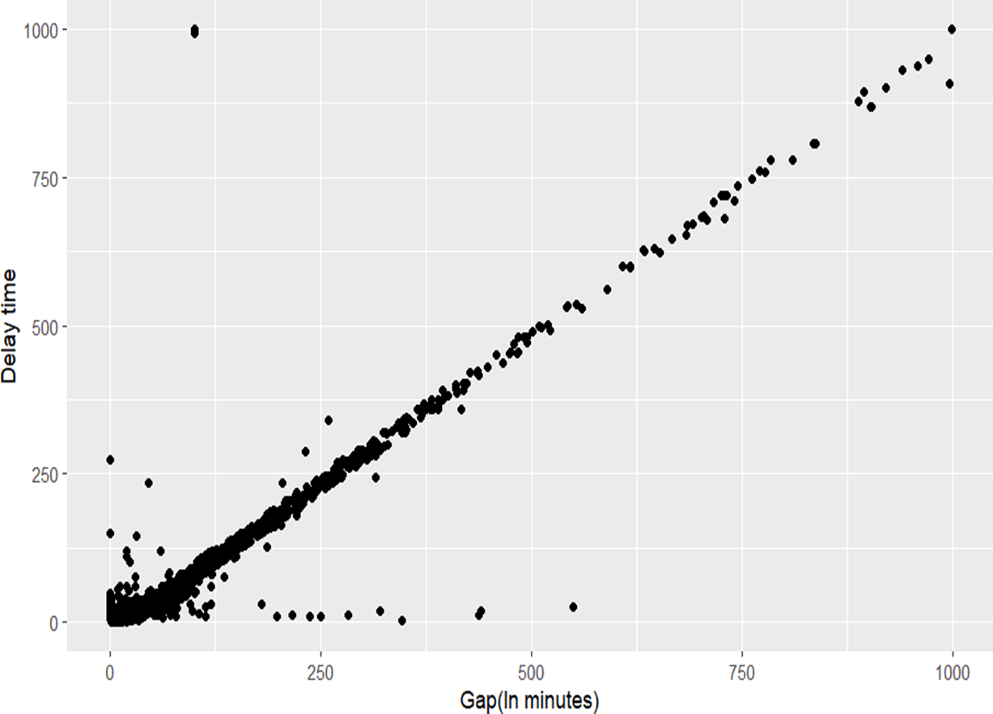
Delay Time vs Time Gap
Perfect Positive
Linear Relationship
Correlation Coefficient
0.96

Slide 12
Delay Time with
Categorical Variables
Variable | P- value
Route_New | <2.2e-16
Direction | <2.2e-16
Hour | < 2.2e-16
Is_Weekday | 4.498e-06
Day | 3.314e-05
Incident_New | < 2.2e-16
At 5% significance level, medians of the response variable, delay time by all the categories of the majority of the categorical variables are significant which suggest there are effects be them on the delay time

Slide 13
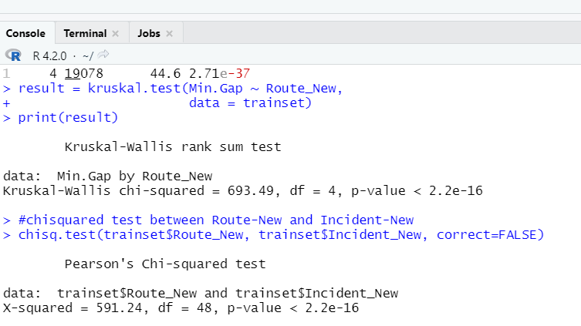
Relationships between
Predictors
i)Time gap Vs Route type
ii) Route_New Vs Incident_New
At 5% significance level, medians of the time gap variable, by all the categories of the Route_New variable are significantly different which suggest there are effects by them on the time gap.
At 5% significance level, there is a significant association between the variables Route_New and Incident_New.

Slide 14
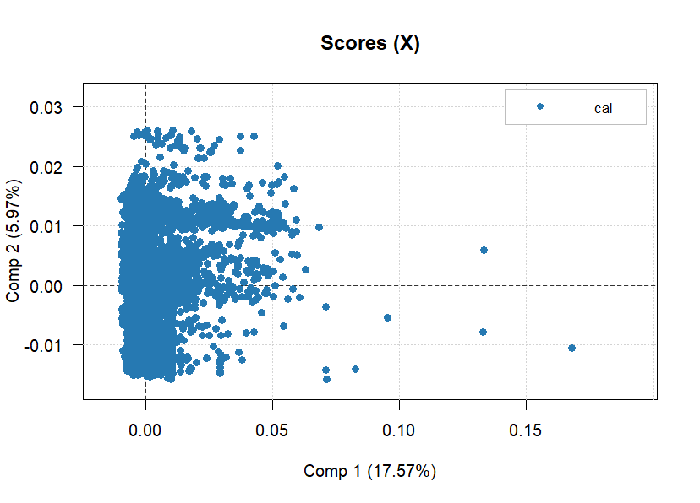
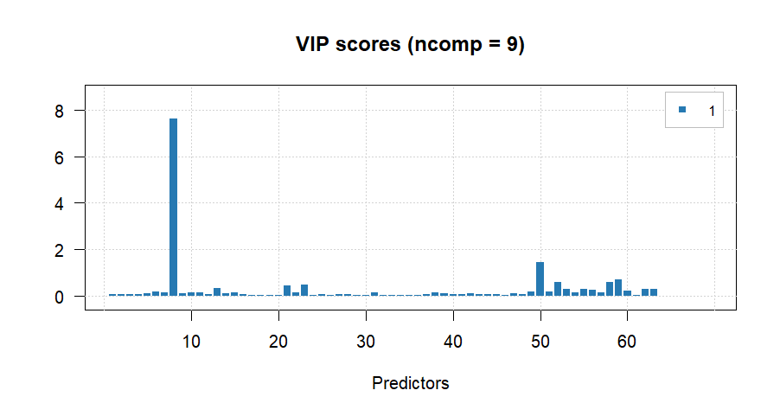
Partial Least Squares Regression
Total variation represented from 19 components
The first two components account for 23.54% of the total variability
Min.Gap
Dominant VIP score for Min.Gap Variable
35 outliers were identified using PLSR.

Slide 15
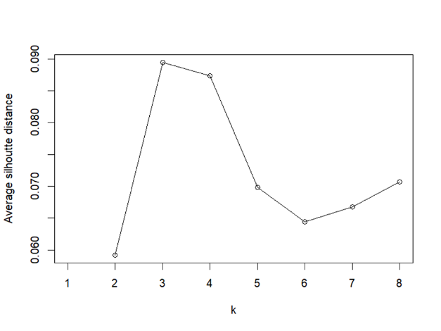
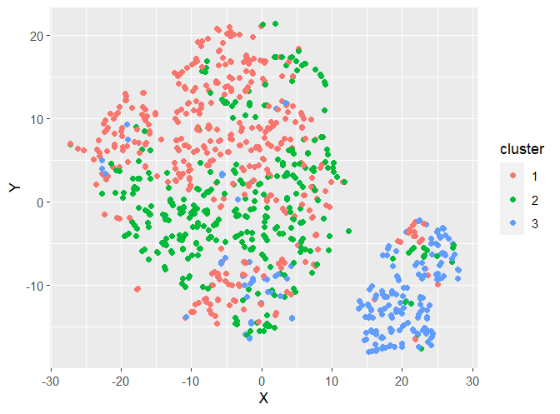
Cluster Analysis
For k values in the range of 2:8
highest value → 0.0894 (k=3)
No clearly distinct clusters

Slide 16


Main Results of the
Advanced Analysis

Slide 17
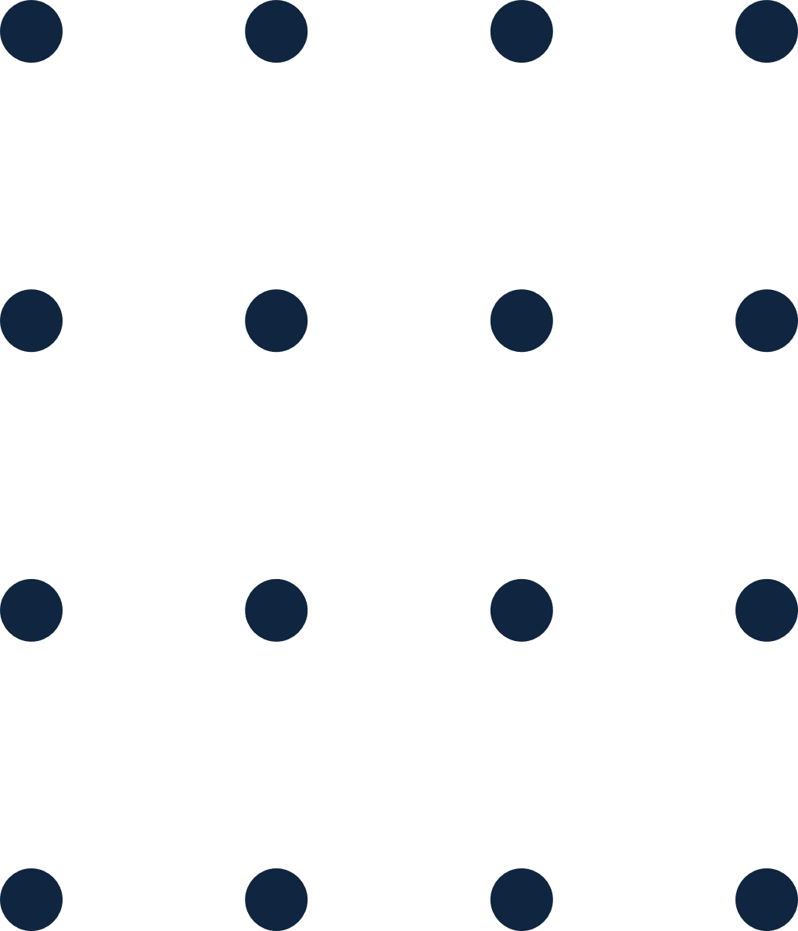
Model
Selection
Model | Training RMSE | Test RMSE | Training MAPE | Test MAPE
Ridge | 4.919888 | 7.255654 | 8.72% | 15.89%
Lasso | 4.93747 | 7.271554 | 8.94% | 16.16%
Elastic Net | 4.797923 | 7.509318 | 8.67% | 22.75%
Because of the presence of association between variables, fitting a multiple linear regression model is not appropriate.
Hence regularization techniques were used to reduce the variance of the coefficient estimates.

Slide 18
For further accuracy……
Model | Best Parameters | Training RMSE | Test RMSE | Training MAPE | Test MAPE
Random Forest | mtry=50 splitrule = variance min.node.size=5 | 3.595297 | 5.278197 | 7.56% | 9.18%
XGBoost | nrounds=500 max_depth=2 eta=0.1 gamma=0.1 colsample_bytree=0.6 min_child_ weight=1 subsample=0.5 | 2.799788 | 5.520246 | 5.58% | 9.57%
Both techniques suggest that prediction accuracy has increased but comparatively the random forest model with all the features shows better results with both less Test RMSE and Test MAPE and comparatively less overfitting.

Slide 19
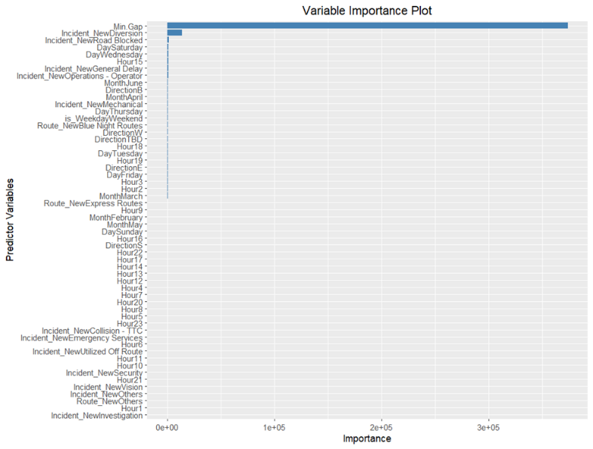
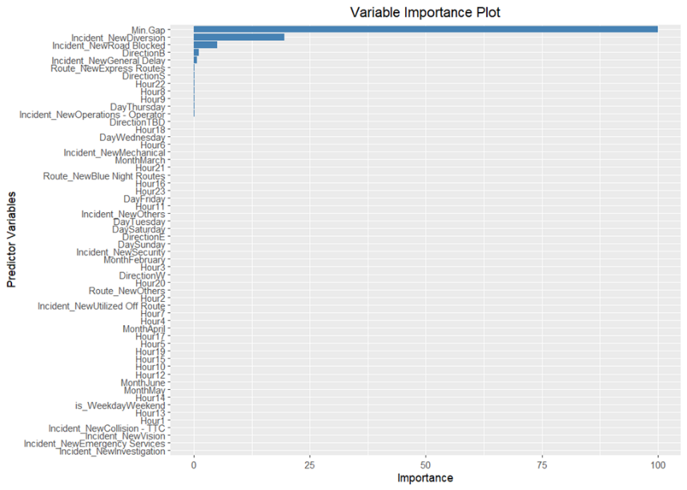
Variable Importance plots
Random Forest
XGBoost Model

Slide 20
Comparison…
 | With all the features |  |  |  | With important features
Model | Training RMSE | Test RMSE | Training MAPE | Test MAPE | Training RMSE | Test RMSE | Training MAPE | Test MAPE
Random Forest | 3.595297 | 5.278197 | 7.56% | 9.18% | 3.746567 | 6.524895 | 8.01% | 14.75%
XGBoost | 2.799788 | 5.520246 | 5.58% | 9.57% | 3.868539 | 6.530456 | 8.05% | 14.86%
In models with the important features , the prediction accuracy has decreased with considerably higher Test MAPE values.
Hence , the Random forest model with all the features is still the best.

Slide 21
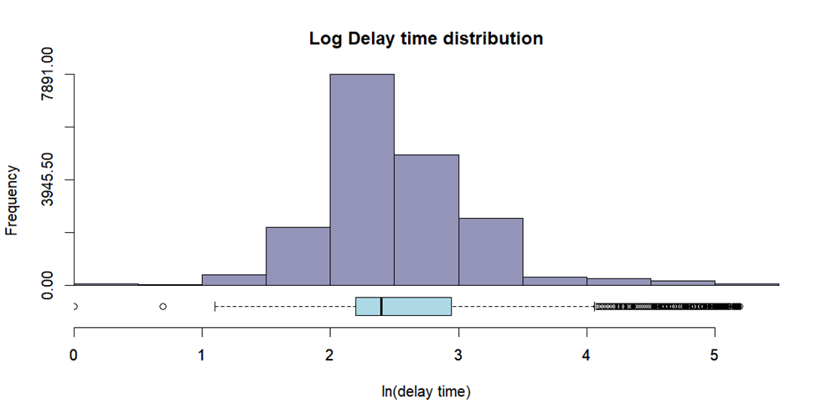
Applying Log Transformation
The response variable’s discreteness and the possession of a positively skewed distribution indicates that using a transformation on the response might produce more accurate predictions. Therefore, log transformation is imposed on the response, Min.Delay .
 | Response – Min.Delay | Response – ln(Min.Delay)
Skewness | 5.192685 | 0.6769573
Kurtosis | 37.93428 | 5.319729

Slide 22
Transformed Ridge, Lasso and Elastic Net models
Model | Training RMSE | Test RMSE | Training MAPE | Test MAPE
Ridge | 30.85677 | 42.79989 | 22.73% | 35.59%
Lasso | 25.99747 | 38.51643 | 20.01% | 25.42%
Elastic Net | 33.03114 | 48.24348 | 23.17% | 35.75%
Above results show that the log transformation has not been successful in fitting linear relationships between the response and predictors.

Slide 23
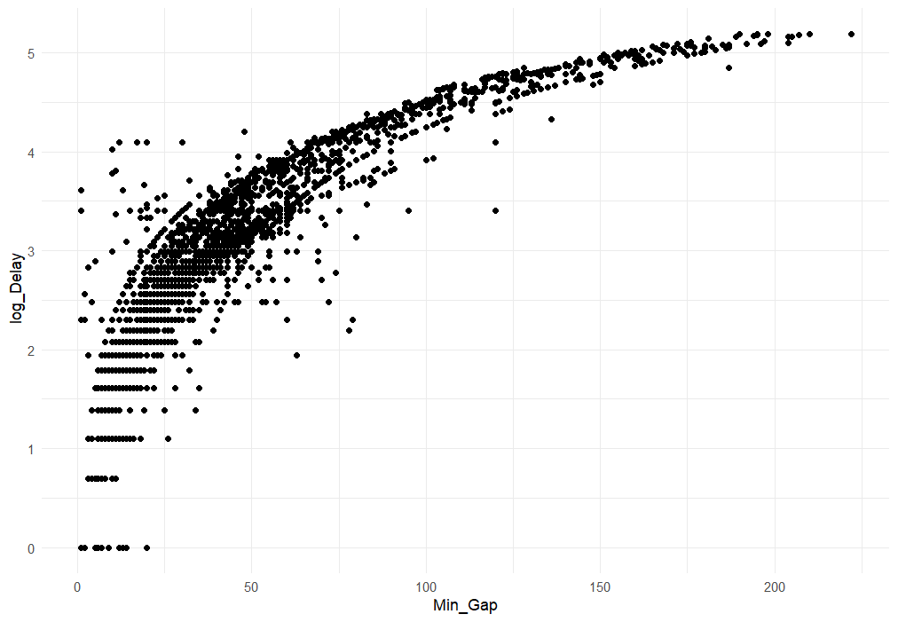
Effects on Predictors
Min.Delay Vs Min.Gap
Log Delay Vs Min.Gap

Slide 24
After log transformation…
Model | Best Parameters | Training RMSE | Test RMSE | Training MAPE | Test MAPE
Random Forest | mtry=35 splitrule=variance min.node.size=5 | 4.571086 | 6.377511 | 9.24% | 13.49%
XGBoost | nrounds=500 max_depth=2 eta=0.1 gamma=0.1 colsample_bytree=0.5 min_child_weight=1 subsample=0.6 | 3.172071 | 6.110895 | 6.27% | 11.97%
Both techniques suggest that prediction accuracy has increased but comparatively the random forest model with all the features shows better results with comparatively less overfitting.

Slide 25
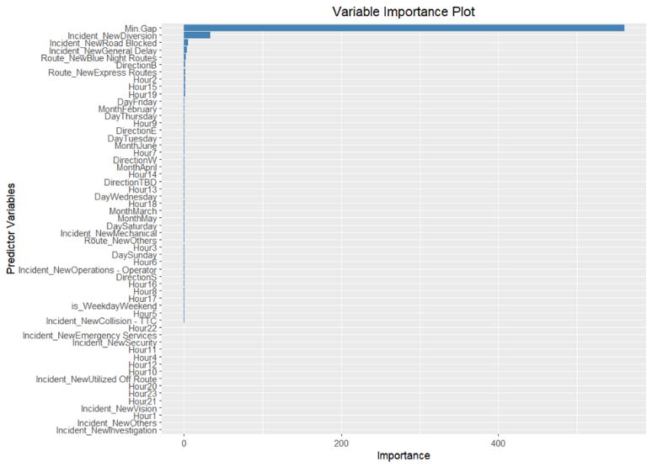
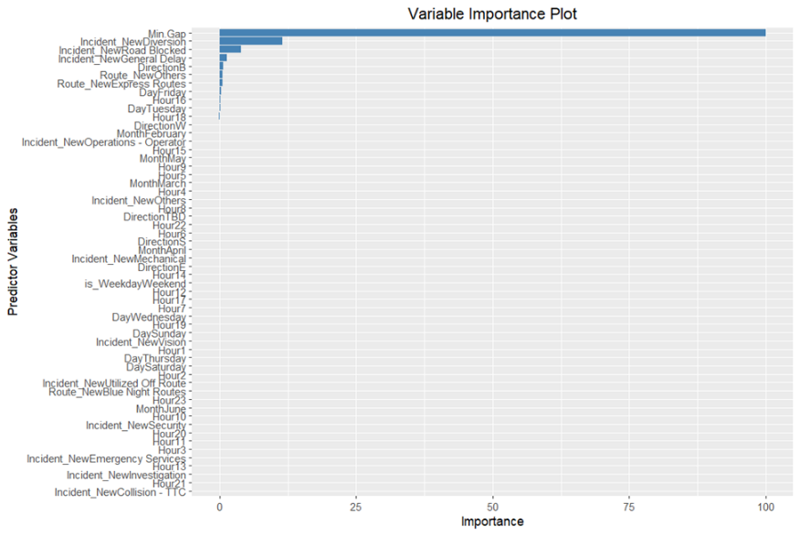
Variable Importance plots
Random Forest
XGBoost Model

Slide 26
Comparison…
 | With all the features |  |  |  | With important features
Model | Training RMSE | Test RMSE | Training MAPE | Test MAPE | Training RMSE | Test RMSE | Training MAPE | Test MAPE
Random Forest | 4.571086 | 6.377511 | 9.24% | 13.49% | 2.654157 | 6.97303 | 4.81% | 14.82%
XGBoost | 3.172071 | 6.110895 | 6.27% | 11.97% | 3.45038 | 6.312643 | 7.13% | 13.28%
In models with the important features , the prediction accuracy has decreased with considerably higher Test MAPE values.
Hence , the Random forest model with all the features has better accuracy.

Slide 27
Comparison…
Without log transformation |  |  |  | With log transformation
Training RMSE | Test RMSE | Training MAPE | Test MAPE | Training RMSE | Test RMSE | Training MAPE | Test MAPE
3.595297 | 5.278197 | 7.56% | 9.18% | 4.571086 | 6.377511 | 9.24% | 13.49%
Out of the 2 random forest models selected with all the features, before and after log transformation, the model with the original response clearly performs better in terms of both RMSEs and MAPEs.

Slide 28
Issues encountered and proposed Solutions
Presence of a large number of factor levels in a categorical variable would make the model very complicated. Therefore, before fitting the models some factor levels with very low representation were combined together with the intention of reducing the number of factor levels in a categorical variable.
The dataset which was used for the analysis comprised of categorical variables with many factor levels. In order to fit a model, these variables had to be replaced with dummy variables. As a result, it caused difficulties in interpreting the model.
When almost all the models didn’t show vast differences in terms of training and test RMSEs, in order to identify which models are overfitted, we considered their training and test MAPEs which paved the path to select the best model.

Slide 29
Conclusion ...
Regularization techniques were not able to provide satisfactory model performances in both scenarios of with and without transformation.
Also, Min.Gap variable is dominant among all the variables in all the variable importance plots (correlation of 0.96 with the response). Due to the above fact, the results of the models with all the features and only the important features didn’t make much difference in RMSE values.
The results obtained in random forest model considering all the features showed the highest accuracy with training test RMSE = 5.278197 and test MAPE=9.18%.
.

Slide 30
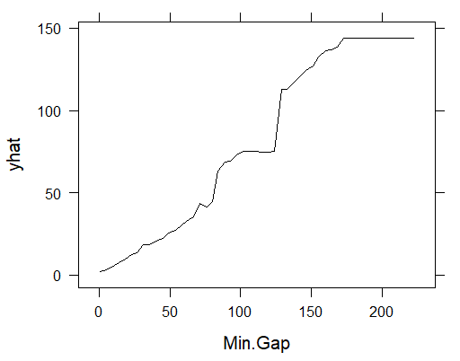
Best Model
When all the models were compared, the Random Forest model applied on the original response considering all the features was identified as the BEST MODEL which produces the most accurate predictions with less information loss.
predicted delay time increases as the time gap increases in the model.

Slide 31
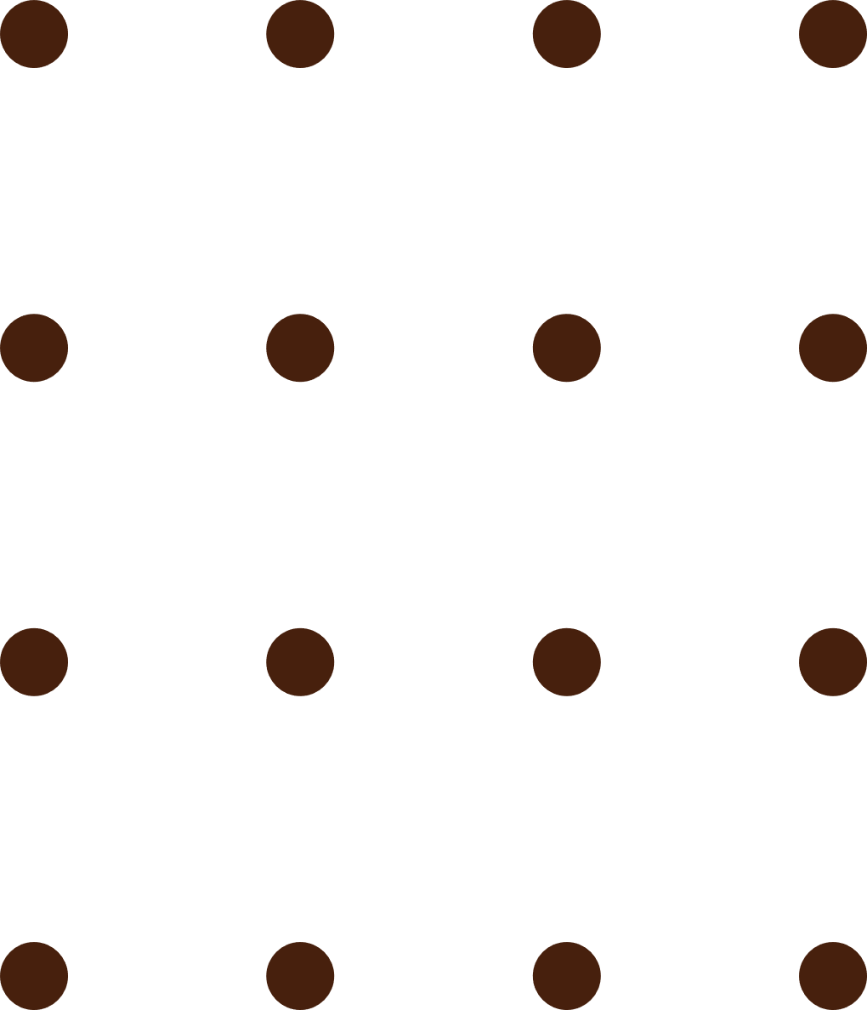
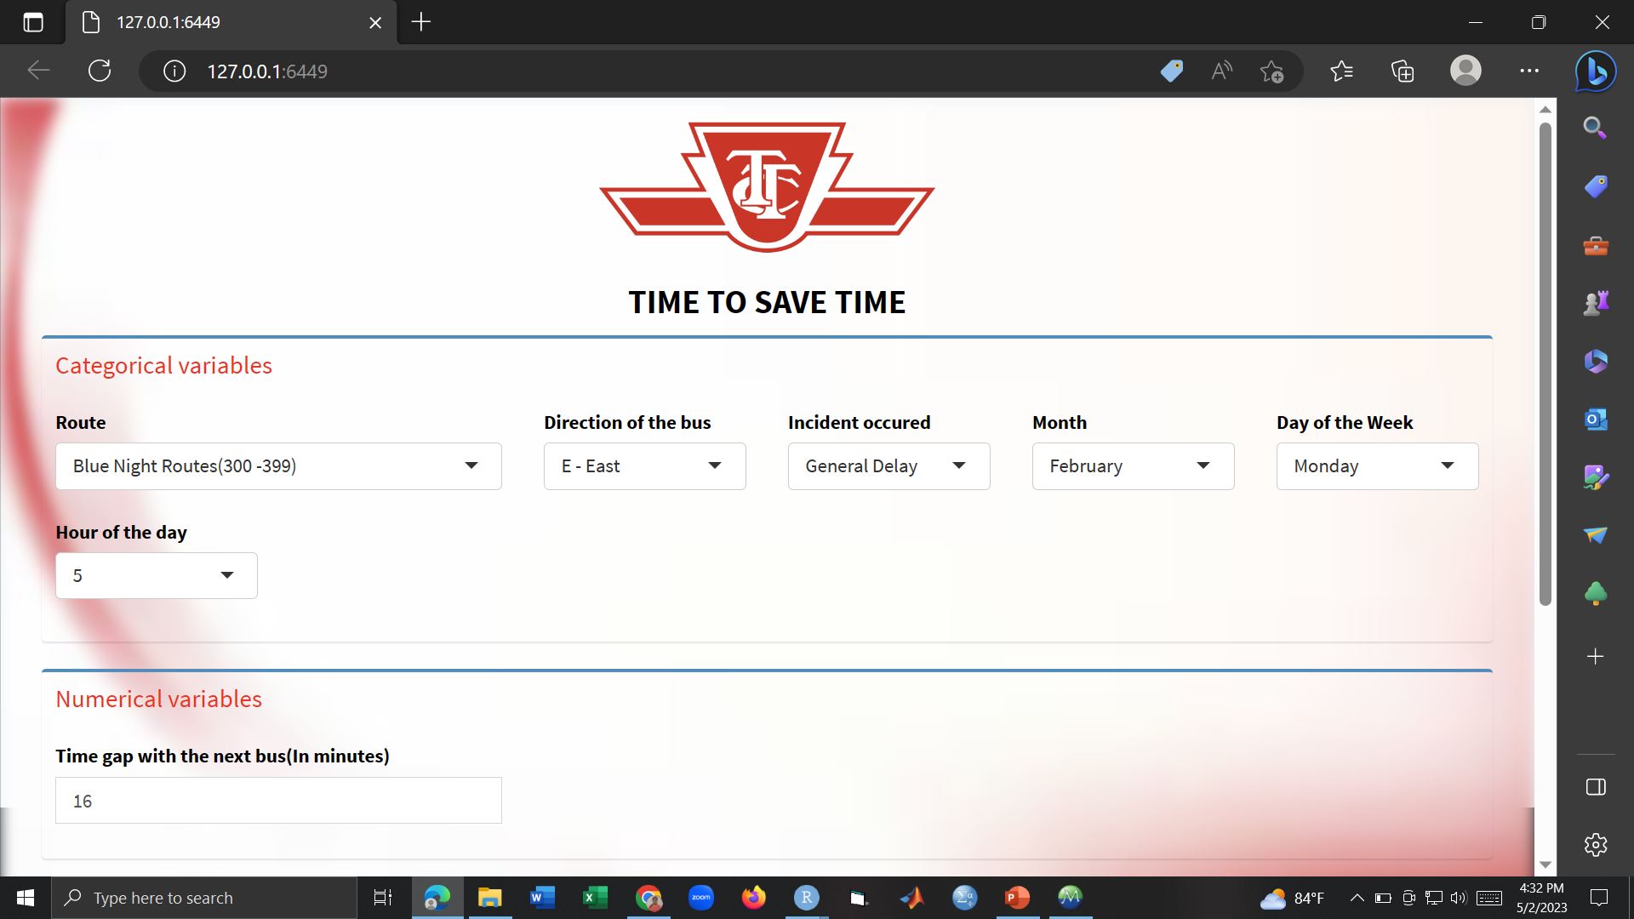
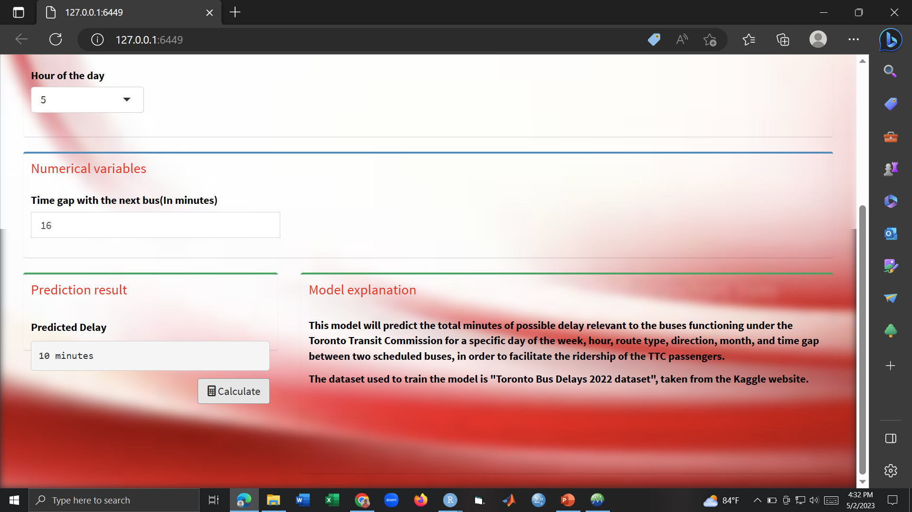
Pred App…

Slide 32
References
TTC data and journals
https://www.ttc.ca/
https://transittoronto.ca/bus/8108.shtml
https://en.wikipedia.org/wiki/List_of_Toronto_Transit_Commission_bus_routes
https://www.blogto.com/city/2014/04/when_exactly_is_rush_hour_in_toronto/
https://www.cp24.com/news/cleaning-now-the-leading-cause-of-ttc-bus-delays-amid-covid-19-pandemic-1.5534154?cache=%3FclipId%3D104070%3FautoPlay%3Dtrue%3FautoPlay%3Dtrue%3Fot%3DAjaxLayout#:~:text=Mechanical%20issues%20were%20to%20blame,accounted%20for%20six%20per%20cent.
Descriptive Analysis
https://www.google.com/amp/s/www.r-bloggers.com/2017/05/how-to-interpret-correspondence-analysis-plots-it-probably-isnt-the-way-you-think/amp/
https://rpubs.com/gaston/MCA
https://onlinelibrary.wiley.com/doi/10.1002/9780470479216.corpsy0491
Advanced Analysis
https://datascienceplus.com/extreme-gradient-boosting-with-r/
https://www.analyticsvidhya.com/blog/2016/03/complete-guide-parameter-tuning-xgboost-with-codes-python/
https://machinelearningmastery.com/feature-selection-with-the-caret-r-package/
https://gsverhoeven.github.io/post/random-forest-rfe_vs_tuning/
https://stats.stackexchange.com/questions/443234/random-forest-in-r-how-to-perform-feature-extraction-and-reach-the-best-accura
https://www.guru99.com/r-random-forest-tutorial.html
https://www.statology.org/what-is-a-good-rmse/
https://pastebin.com/8xYGccg7
https://github.com/amunategui/BetterCrossValidation/blob/master/CrossValidation2.R
https://machinelearningmastery.com/tune-machine-learning-algorithms-in-r/
https://nanx.me/enpls/reference/enspls.od.html
https://www.r-bloggers.com/2020/03/tuning-random-forest-hyperparameters-with-tidytuesday-trees-data/

Slide 33
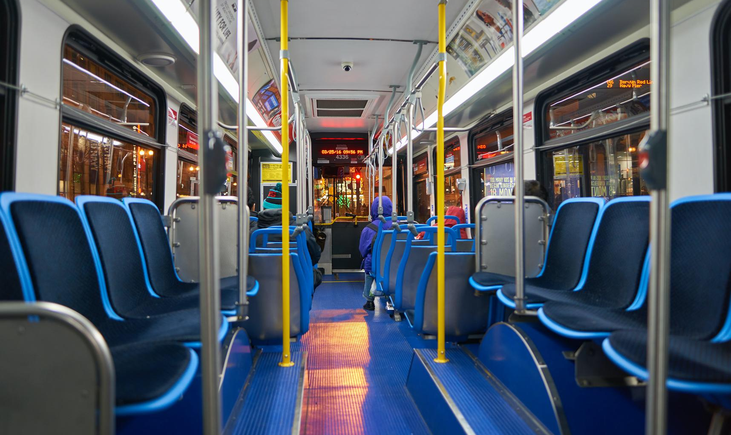
THANK YOU!

